Slide 1
Going Deeper with Convolutions
Sungjoon Choi

Slide 2


Slide 3

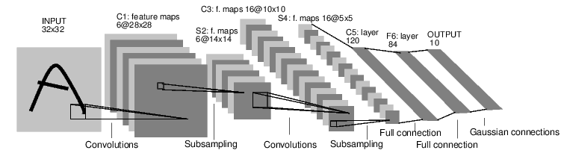

GoogLeNet

Slide 4
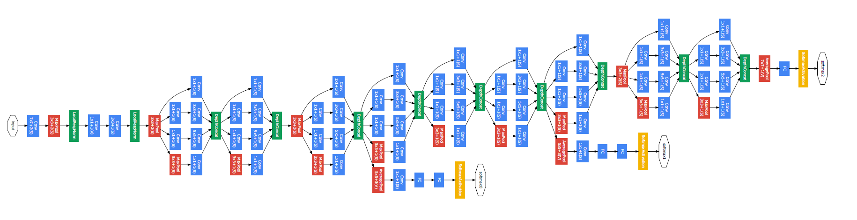
GoogLeNet
22 Layers Deep Network
Efficiently utilized computing resources, “Inception Module”
Significantly outperforms previous methods on ILSVRC 2014

Slide 5
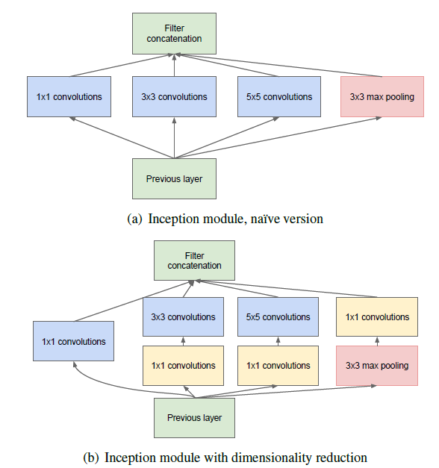
Inception Module

Slide 6
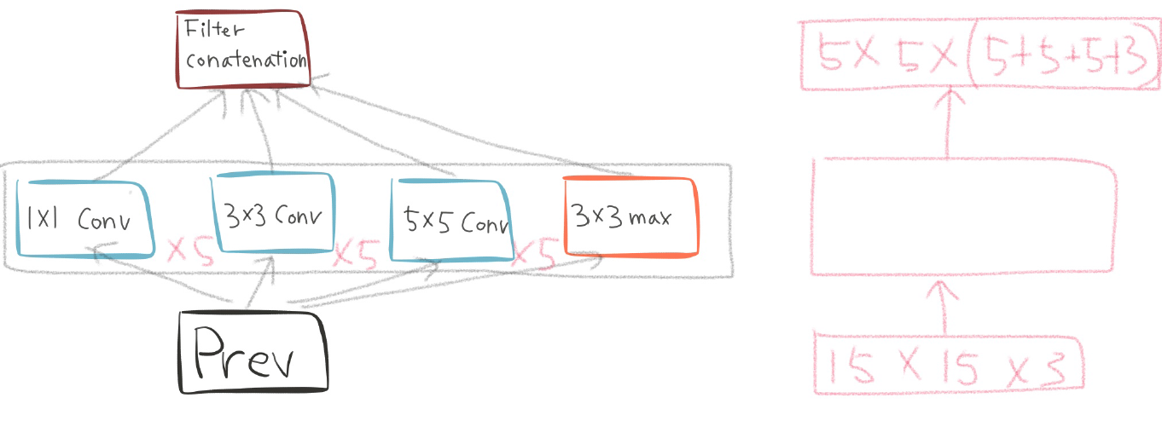
Naive Inception Module

Slide 7
Naive Inception Module

Slide 8
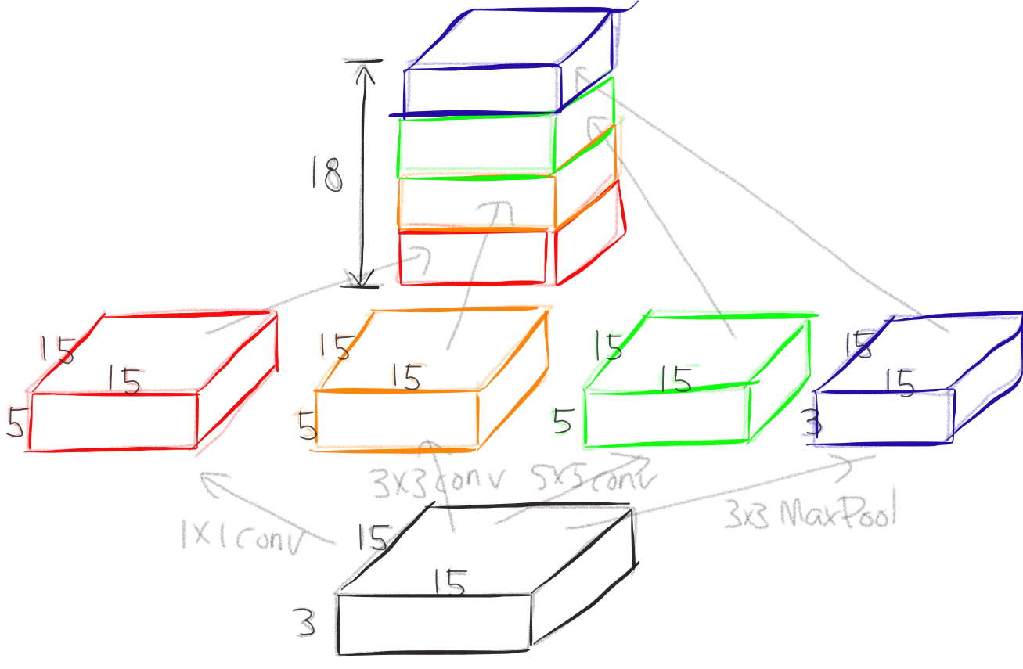
Naive Inception Module

Slide 9
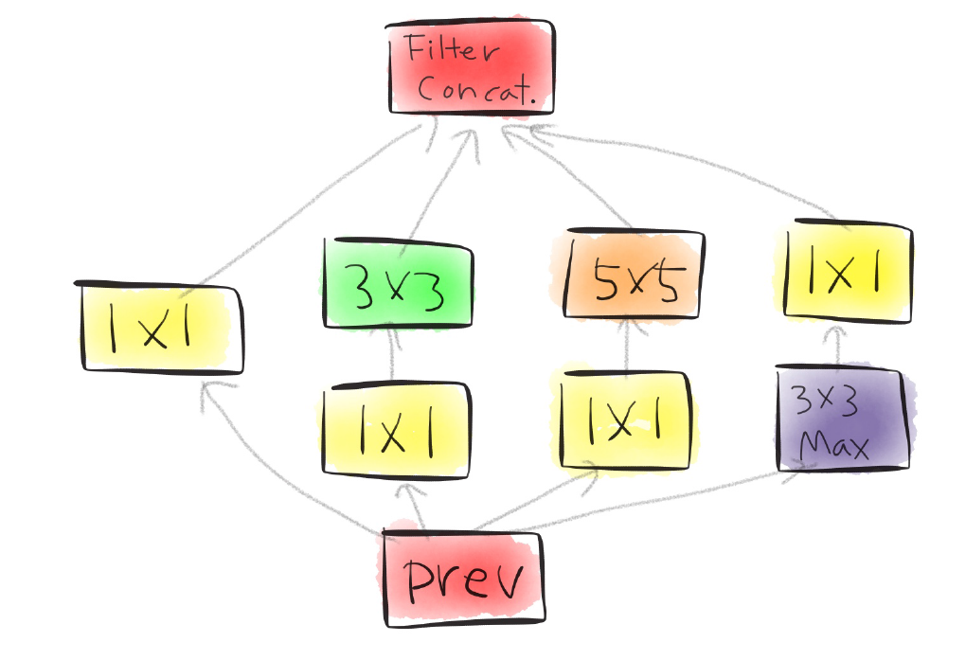
Actual Inception Module

Slide 10

One by One Convolution

Slide 11
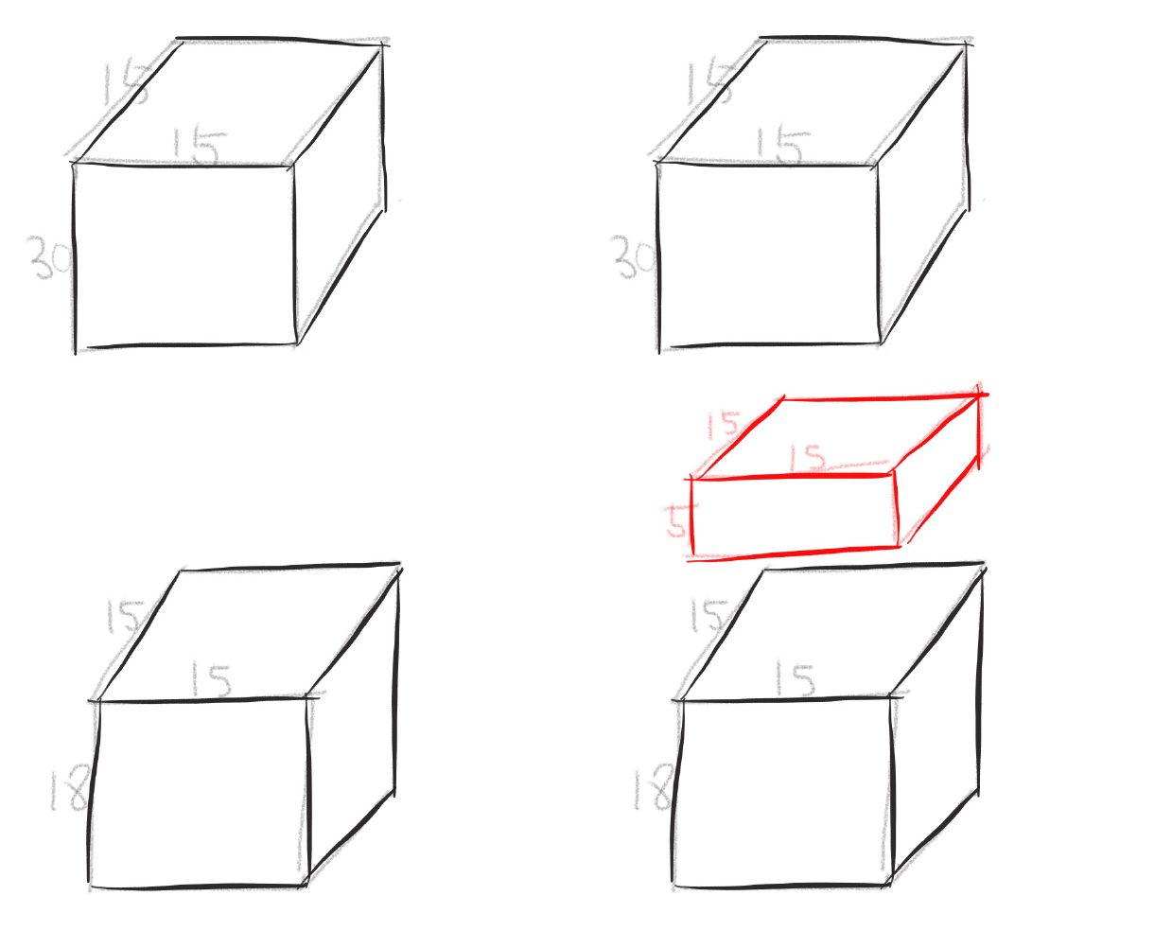
One by One Convolution

Slide 12
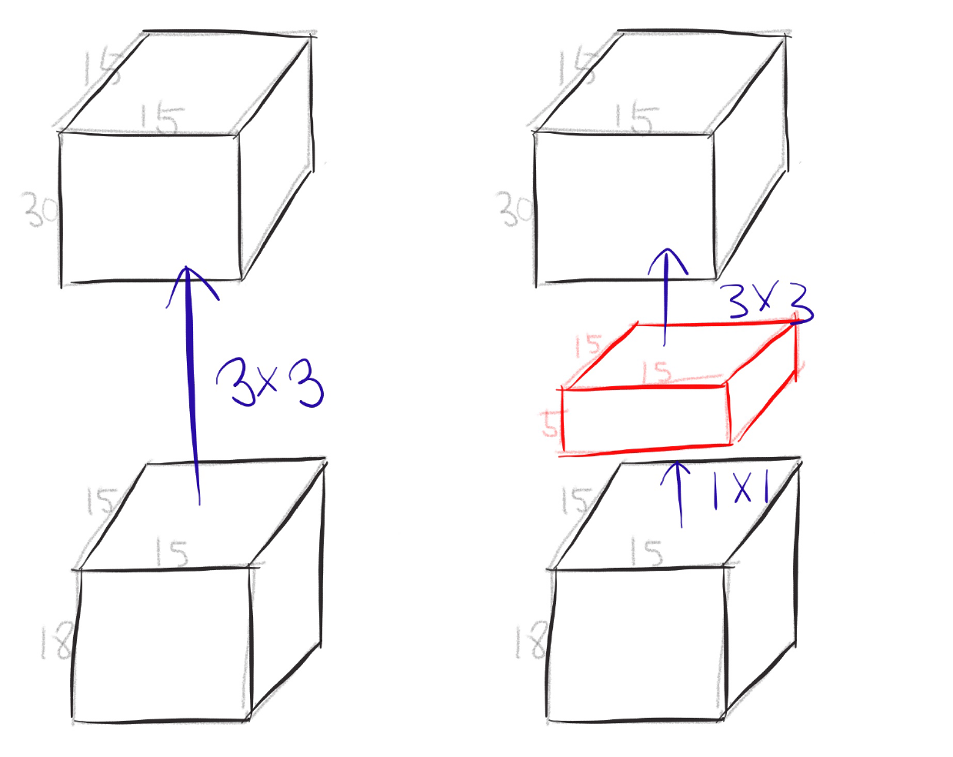
One by One Convolution

Slide 13
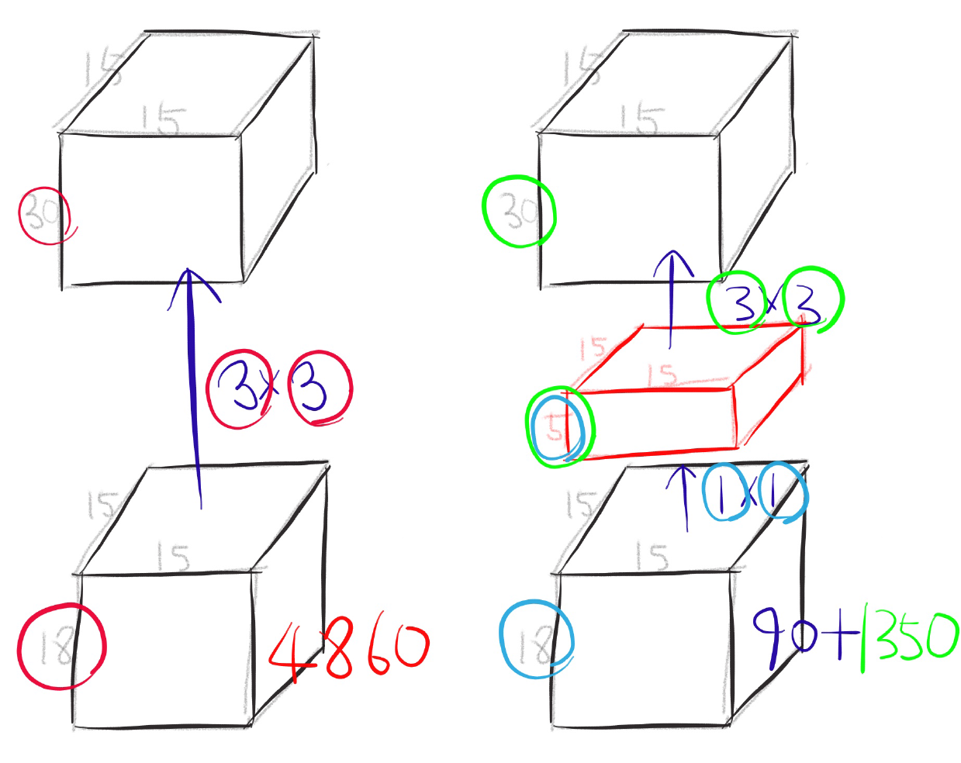
One by One Convolution

Slide 14
GoogLeNet
Network in Network!

Slide 15

Conclusion
Very clever idea of using one by one convolution for dimension reduction!
Other than that...

